Slide 1


MARKETING BUSINESS ANALYTICS AND INSIGHTS
GROUP 10
NIKE
Nikhil Verma
Sarthak Verma
Shobha Ojha
Shreya Bhatt
Sanjana Pandey
Sesha Sai Krishna Sudi

Slide 2




ABOUT NIKE
Nike, Inc., originally founded as Blue Ribbon Sports in 1964 by Bill Bowerman and Phil Knight, was rebranded in 1971. Headquartered in Beaverton, Oregon, this multinational corporation designs, manufactures, and markets athletic footwear, apparel, and accessories. With operations in over 170 countries, Nike is known for innovative shoe designs and iconic marketing, and is a leader in the global sports apparel industry.
BUSINESS
OBJECTIVES
The company focuses on investing in digital technology to deepen customer engagement and streamline the shopping experience, while also optimizing its supply chain to boost efficiency and responsiveness to market changes and consumer demands.
Nike is dedicated to expanding its global influence and market share through continuous innovation in product lines, emphasizing sustainability to minimize environmental impact, and promoting diversity and inclusion to value each individual’s unique contributions.

Slide 3





KEY PERFORMANCE INDICATORS
Revenue
Sessions
Conversion Rate
Revenue
Revenue by Product Name
Revenue by City
Average Order Value
Session by Age
Average Session Duration
Session by Marketing Channel
Session by Device
Now Key Event Rate
By Purchase
Add to Cart

Slide 4

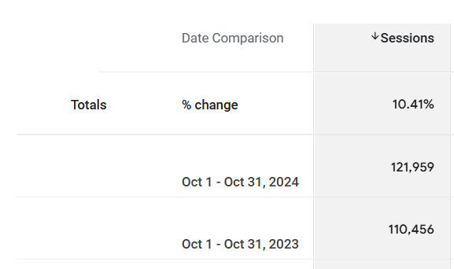
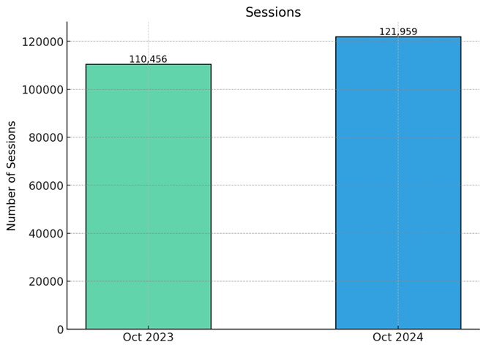
SESSIONS
Observations: The total number of sessions increased from 110,456 in October 2023 to 121,959 in October 2024, showing a notable growth of 10.4% year-over-year.
The increase indicates growing engagement or interest among the user base, with most of the growth driven by younger and older age groups.
While the total sessions grew, certain middle-age groups (25-44) showed declines, which could highlight shifting user preferences or reduced engagement in these segments.

Slide 5
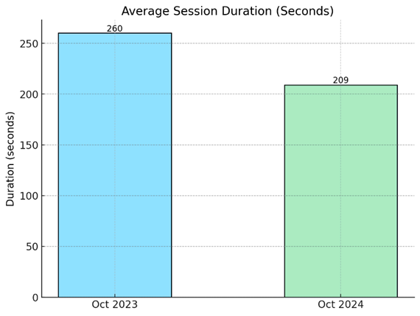
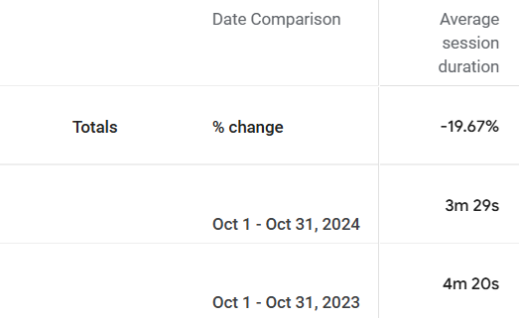
AVERAGE SESSION DURATION
Observations:The average session duration decreased from 260 seconds in 2023 to 209 seconds in 2024, a reduction of about 19.6%.
This indicates that although more users visited the platform, their time spent during each session was shorter, suggesting potential engagement challenges or faster consumption of content.
The reduced session duration could also imply changing user behavior, such as preferring quick interactions over prolonged sessions.

Slide 6
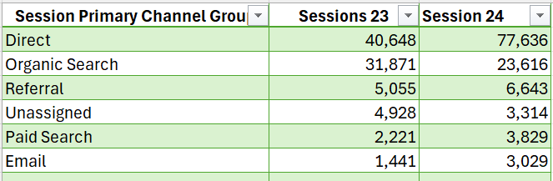
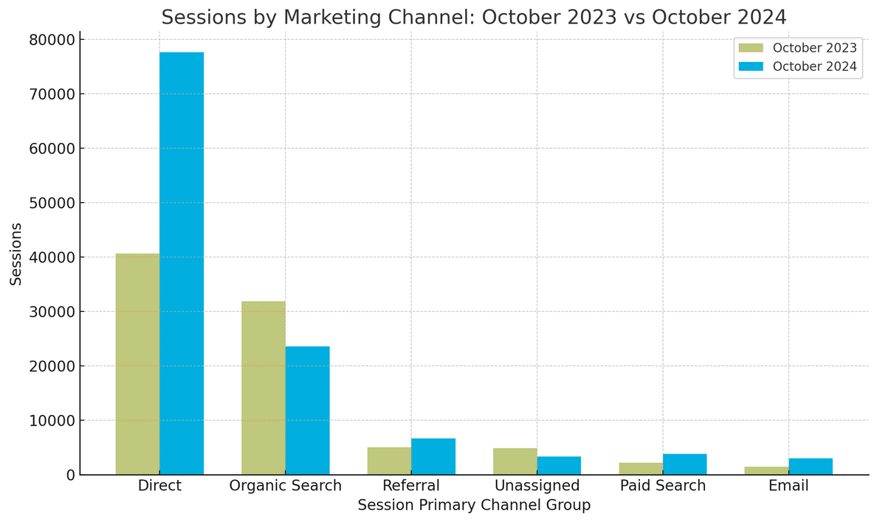
SESSIONS: BY MARKETING CHANNEL
Observations:
Direct Channel: Dominated with 47.2% of total sessions in 2023.
Organic Search: Made up a significant portion at 37%, showing its importance during that period.
Other channels, such as Referral, Paid Search, and Email, held relatively smaller shares, collectively contributing less than 20%.

Slide 7
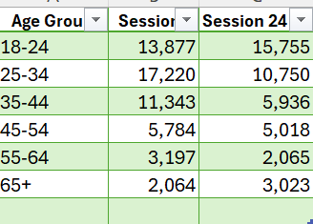
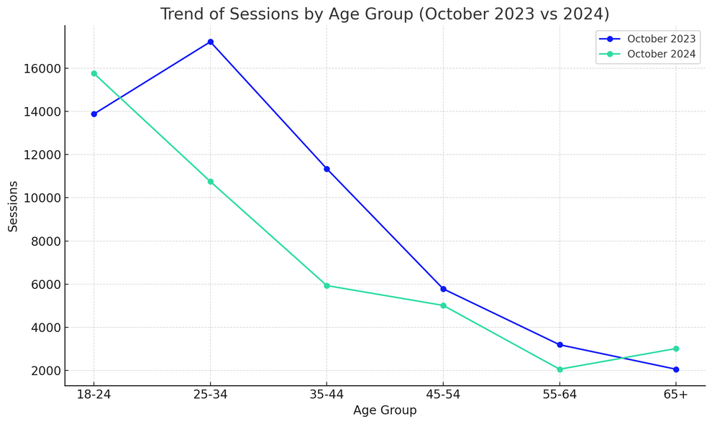
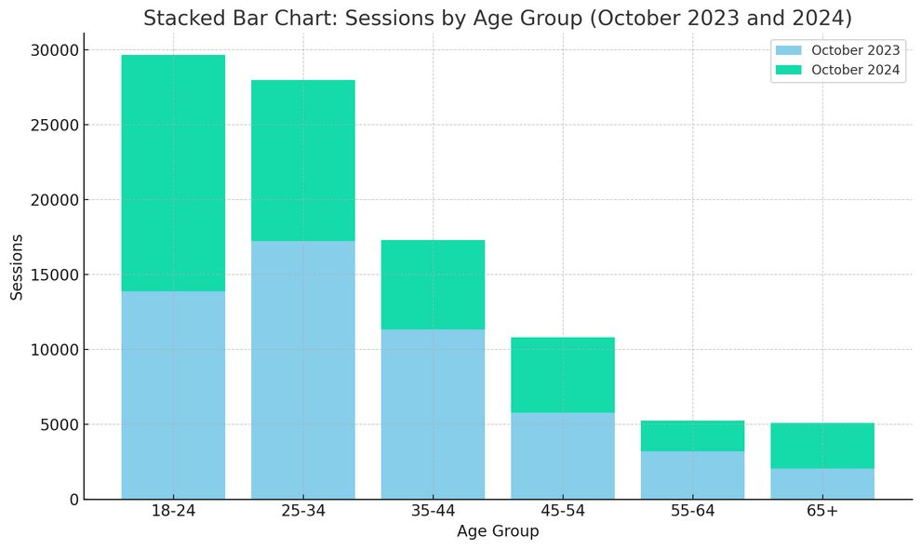
SESSIONS: BY AGE
Observations:
The 18-24 age group shows a clear increase and steady upward trend from 2023 to 2024, making it the most dominant group in 2024.
The 25-34 and 35-44 age groups show steep declines in their contributions, with their 2024 session counts being significantly lower.
The 65+ age group stands out for its proportional growth in sessions, indicating a demographic shift towards older users.

Slide 8
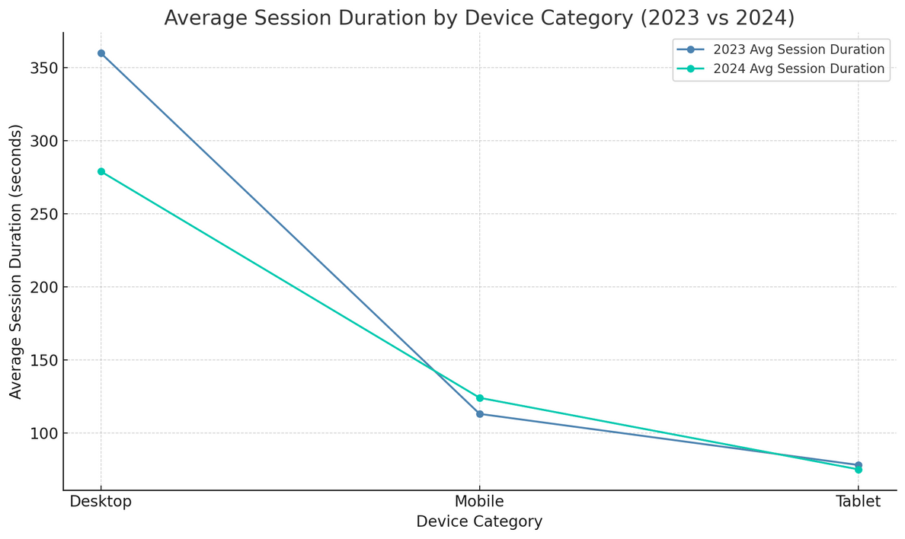
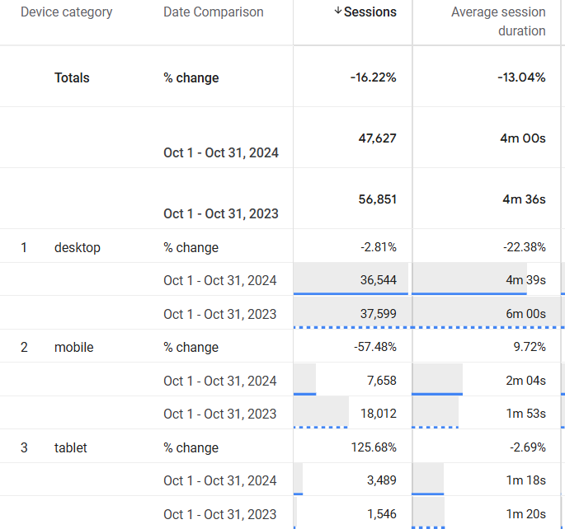
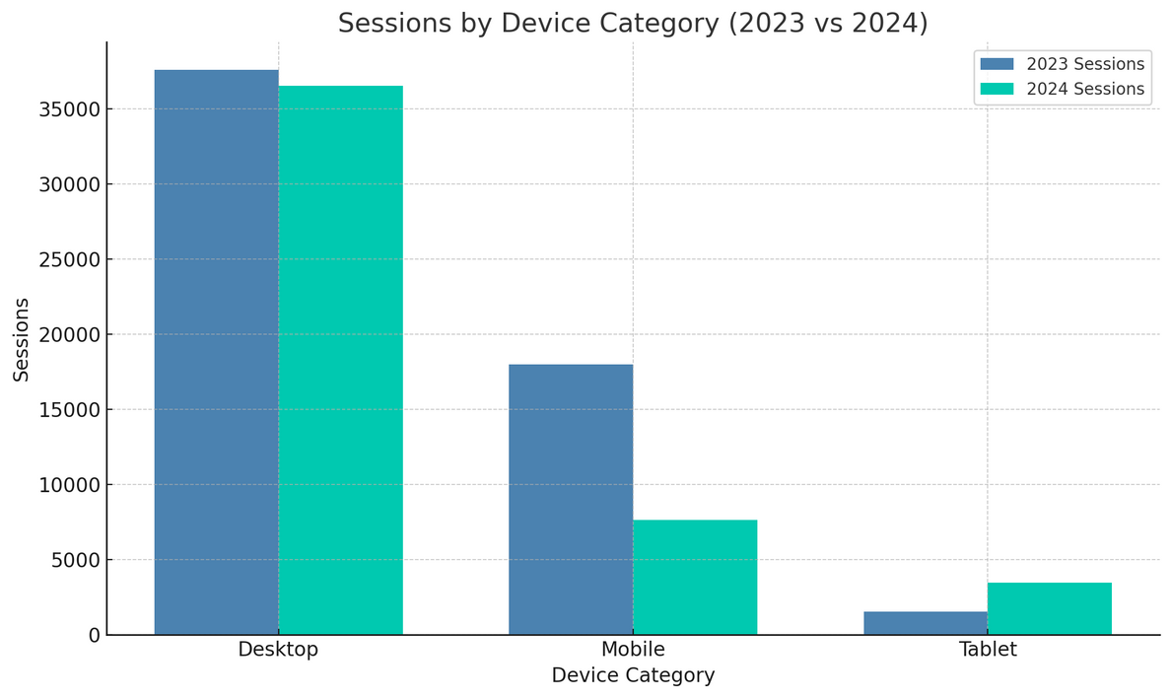
SESSIONS : BY DEVICE
Observations:
Sessions dropped overall, with mobile showing a dramatic decline and tablet sessions increasing by over 125%.
Average session duration decreased, especially on desktops, impacting overall engagement time.
Despite fewer mobile sessions, mobile engagement quality improved, as shown by a rise in session duration.

Slide 9
RECOMMENDATIONS
Optimize for Mobile Users:
Focus on improving the user experience on mobile devices, as mobile sessions have declined significantly while average session duration has slightly increased.
Implement responsive design, faster loading times, mobile-friendly navigation, and optimized images to enhance engagement and attract more mobile users.
Leverage Paid Channels:
Develop a robust marketing strategy for paid channels (e.g., Search and Display Ads) to increase their contribution to overall traffic.
Aim to improve Click Through Rates (CTR) and conversion rates for better ROI, addressing the low contribution of paid channels to total sessions.
Enhance Desktop Engagement:
With desktops maintaining the highest session counts but declining in average session duration, focus on strategies to re-engage desktop users.
Improve site speed, interactive content, and targeted campaigns for desktop users to retain engagement.
Target Age Group 18-34:
Continue investing in content and campaigns tailored for the 18-34 age group, which makes up the largest share of traffic.
Explore new content formats, products, and offers relevant to this demographic to sustain and grow their engagement.
Capitalize on Tablet Growth:
With sessions from tablets increasing by over 125%, optimize content for tablet screens and create tailored campaigns to further engage this growing audience segment.
Test tablet-specific ad creatives to enhance performance on this device.

Slide 10
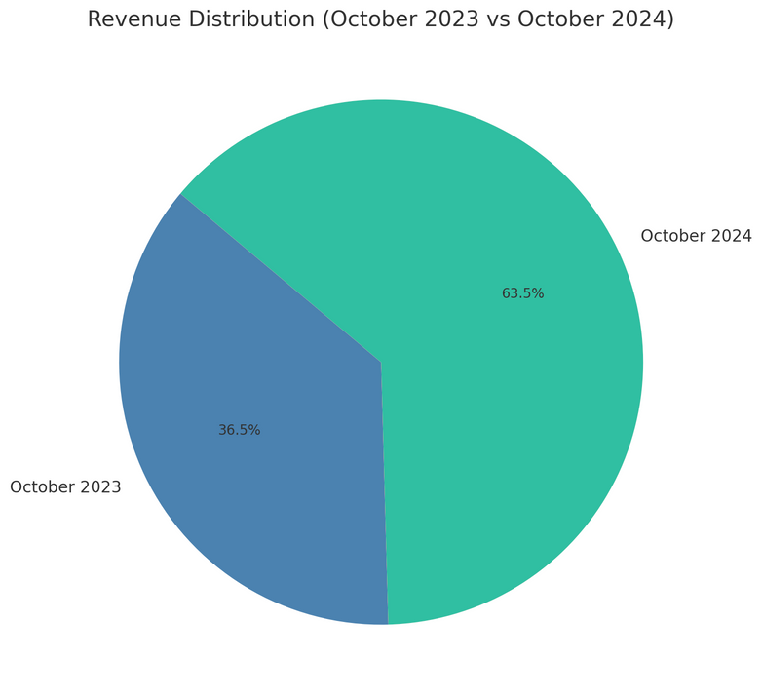
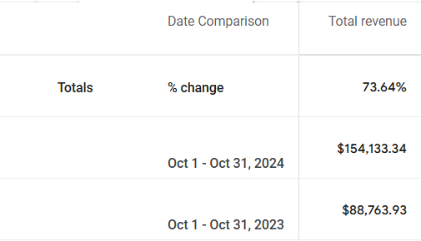
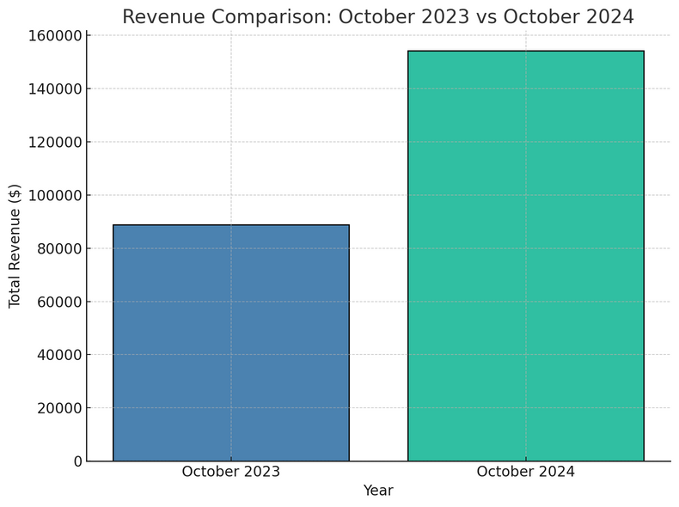
REVENUE
Observations:
Revenue Growth: Total revenue increased by 73.64%, rising from $88,763.93 in 2023 to $154,133.34 in 2024, indicating a substantial improvement in business performance.
Year-on-Year Distribution: Revenue for October 2024 makes up the majority share (63.5%) of the two years, demonstrating significant progress in generating revenue within a single year.
Performance Impact: This growth reflects effective operational, marketing, or sales strategies during this period, suggesting opportunities to build on successful tactics.

Slide 11
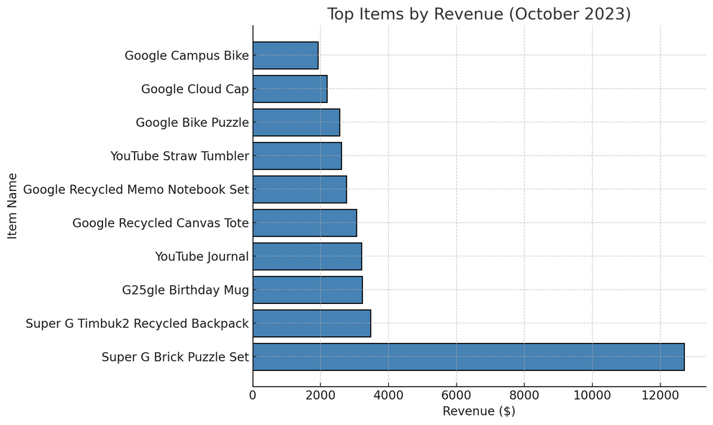
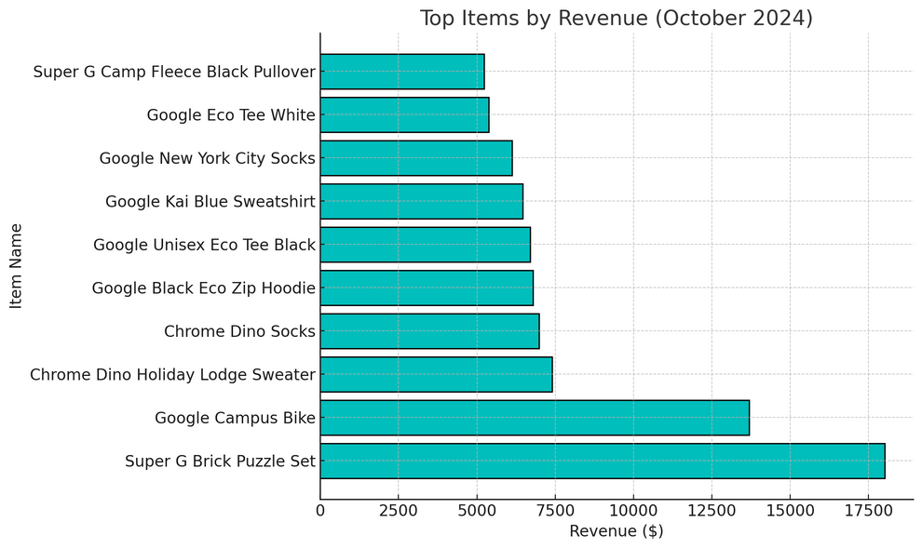
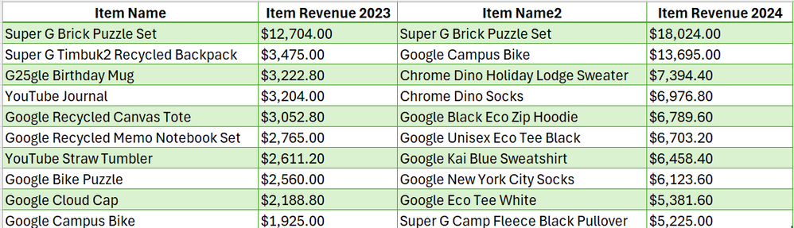
REVENUE: BY PRODUCT NAME
Observations
Consistent Top Performer: The Super G Brick Puzzle Set was the best-selling item in both years, with revenue increasing significantly from $12,704 in 2023 to $18,024 in 2024, demonstrating strong and sustained demand.
Emergence of New High Performers: In 2024, items like the Google Campus Bike and Chrome Dino Holiday Lodge Sweater became significant contributors to revenue, while some 2023 items (e.g., Super G Timbuk2 Recycled Backpack) were replaced by newer products.
Increased Revenue Diversity: The revenue base expanded in 2024, with new products such as Google Eco Tee White and Super G Camp Fleece Black Pullover driving a more balanced revenue distribution across items compared to 2023.
Growth Trend: Many of the top items saw significant revenue growth in 2024, reflecting successful product launches or enhanced sales strategies, contributing to overall revenue growth across both years.

Slide 12
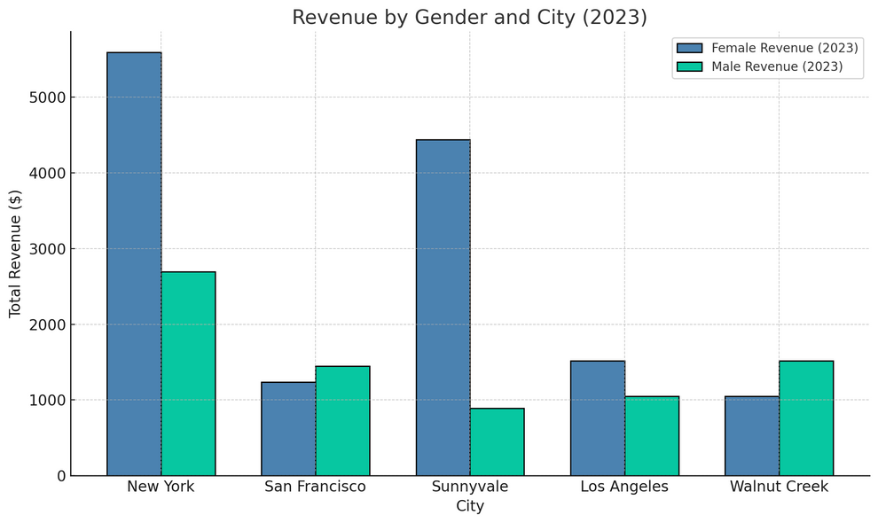
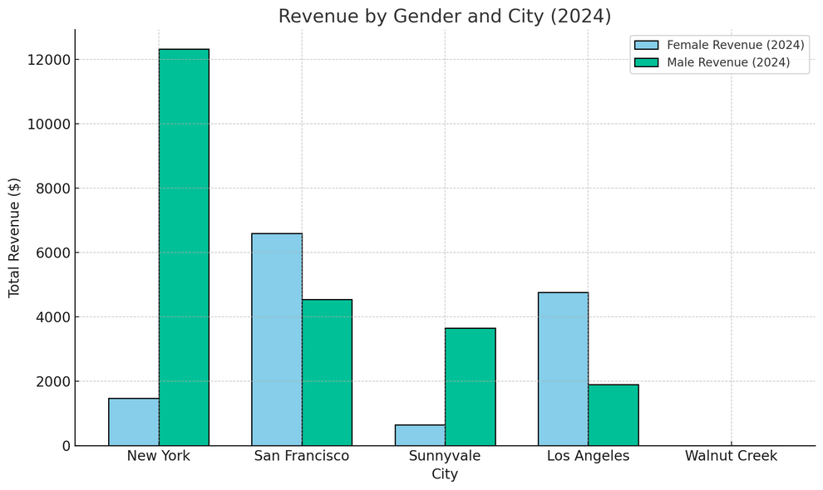
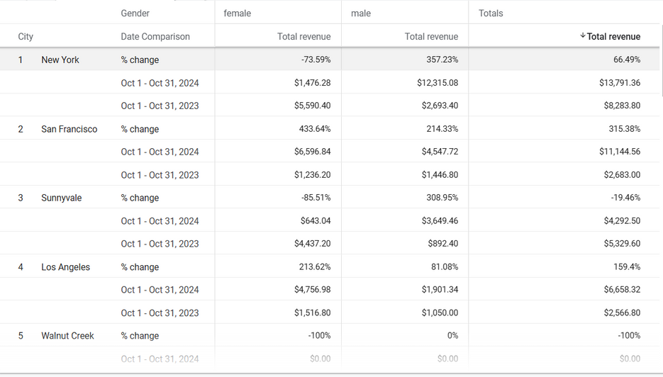
TOTAL REVENUE BY CITY AND GENDER
Observations
Gender-Specific Revenue Trends:
New York: Male revenue surged by 357.23% (from $2,693.40 to $12,315.08), while female revenue dropped by -73.59%.
San Francisco: Both genders grew significantly, with females increasing by 433.64% and males by 214.33%, driving overall growth of 315.38%.
Underperforming Cities:
Sunnyvale: Male revenue rose by 308.95%, but a -85.51% drop in female revenue caused total revenue to decline by -19.46%.
Walnut Creek: Revenue fell to $0 for both genders in 2024.
Gender Balance Shifts:
Los Angeles: Female revenue grew by 213.62% and male revenue by 81.08%, leading to a total growth of 159.4%.

Slide 13
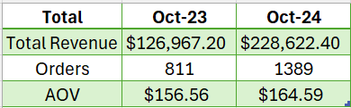
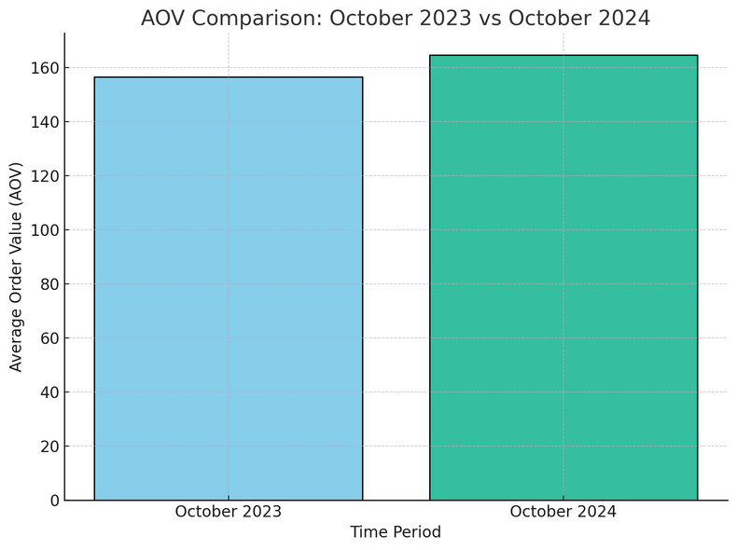
REVENUE :BY AVERAGE ORDER VALUE
Observations
Average order value increased from $156.56 in October 2023 to $164.59 in October 2024, reflecting a 5.12% growth.
The improvement in the average order value indicates increased revenue per transaction, showcasing a positive trend in customer spending behavior.

Slide 14
RECOMMENDATIONS
Expand Success in High-Performing Markets:
Double down on efforts in New York and San Francisco, focusing on products and campaigns resonating with male audiences.
Address the decline in Sunnyvale by targeting female audiences with promotions or new product launches tailored to their preferences.
Leverage Product Insights:
Invest in the production and marketing of high-performing products like the Super G Brick Puzzle Set and Google Campus Bike while phasing out underperforming ones.
Use customer feedback to refine emerging products and ensure alignment with market demand.
Increase Average Order Value (AOV):
Introduce upselling and bundling strategies for top products to further boost AOV.
Offer tiered discounts (e.g., buy more, save more) to encourage higher spending per transaction.
Focus on Gender Balance:
Tailor marketing strategies to re-engage female audiences in cities like New York and Sunnyvale, leveraging loyalty programs and personalized discounts.
Continue optimizing campaigns for male audiences to maintain their growing contribution across key markets.
Optimize Omni-Channel and Device Strategy:
Ensure seamless mobile and tablet shopping experiences as engagement shifts towards these devices.
Expand marketing efforts on paid and referral channels that showed strong conversion potential.

Slide 15
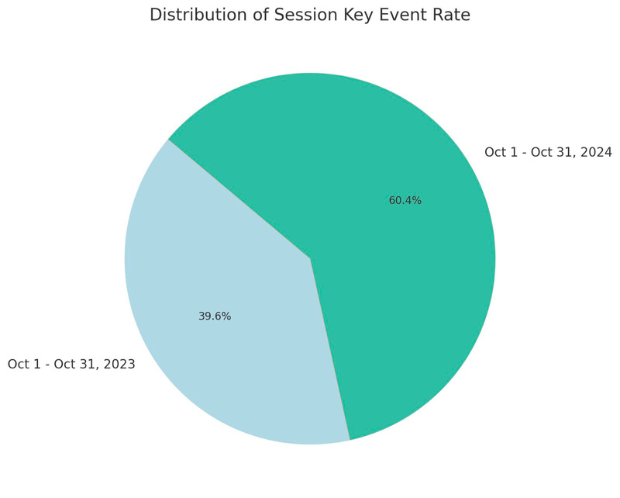
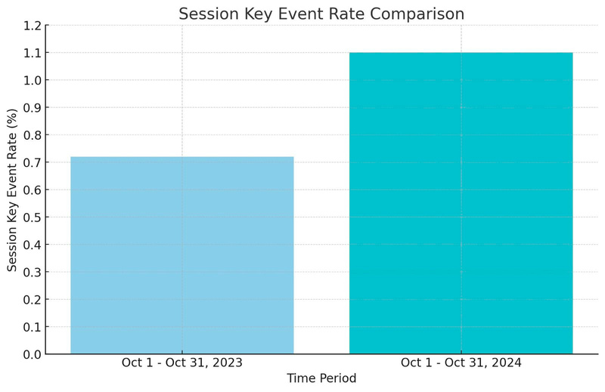
CONVERSION RATE
(NOW KEY EVENT RATE)
Observations:
Overall, the chart shows a significant increase in the Session Key Event Rate from October 1st to 31st, 2023 to the same period in 2024.
Year-on-Year Distribution: The Session Key Event Rate has risen from approximately 0.7% in 2023 to 1.1% in 2024.
Performance Impact: This increased session key event rate in 2024 could be attributed to effective marketing campaigns, website/app improvements, and potential seasonal influences.

Slide 16
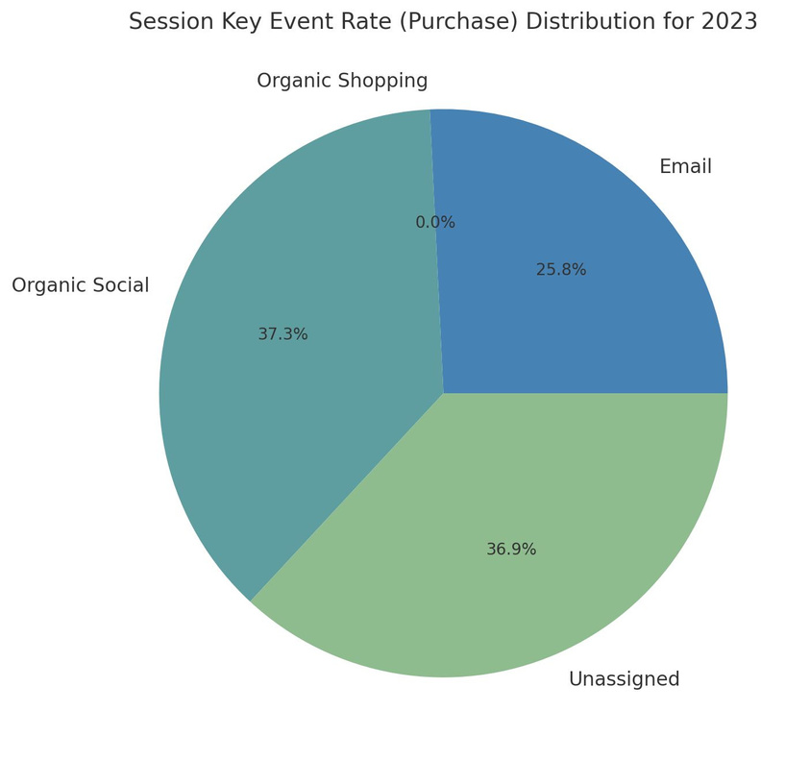
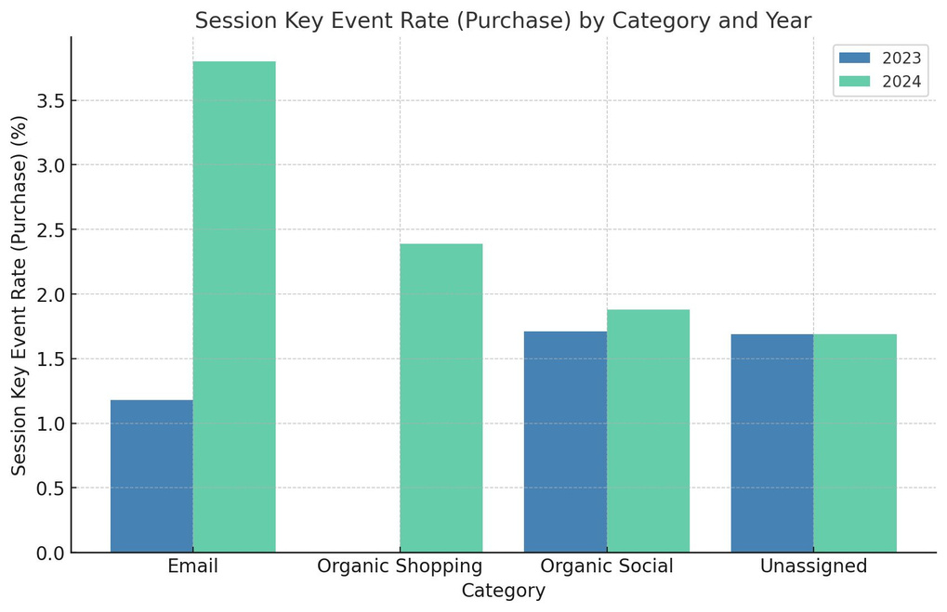
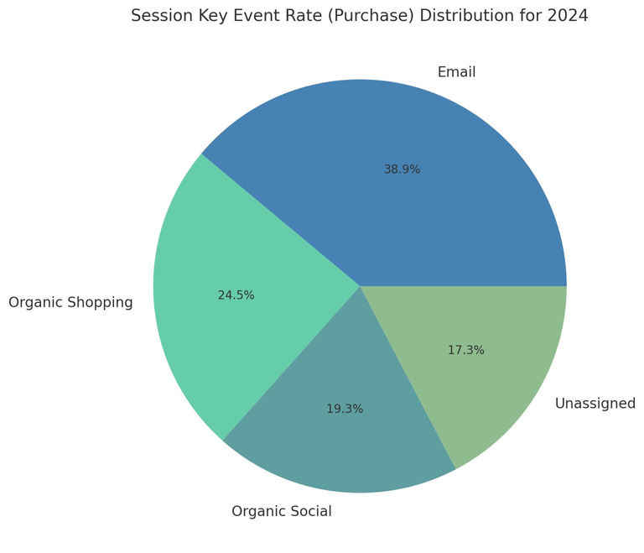
CONVERSION RATE:BY PURCHASE
Observations (with Metrics)
In all channels, the session key event rate for purchases has either remained stagnant or increased from 2023 to 2024, implying that Nike has been more successful in converting users into customers across multiple channels in 2024.
In 2023, Organic Social was the primary driver of purchases, accounting for nearly 37.3% of the total. This indicates a strong reliance on social media platforms to attract and convert customers.
While in 2024, Email emerged as the leading channel, contributing to 38.9% of purchases. This suggests that Nike successfully pivoted its marketing strategy to leverage email marketing more effectively.

Slide 17
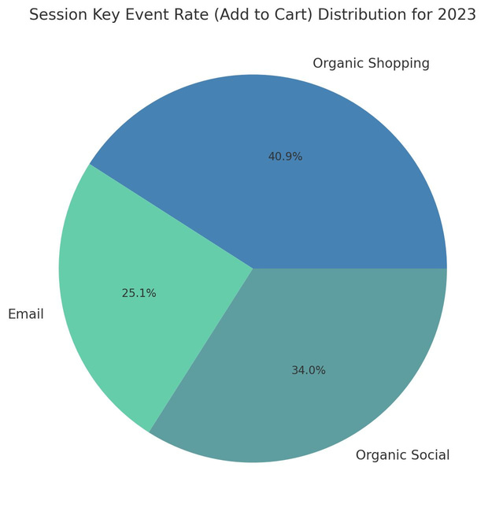
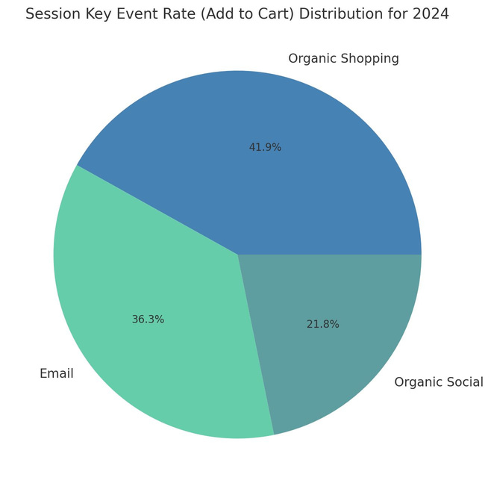
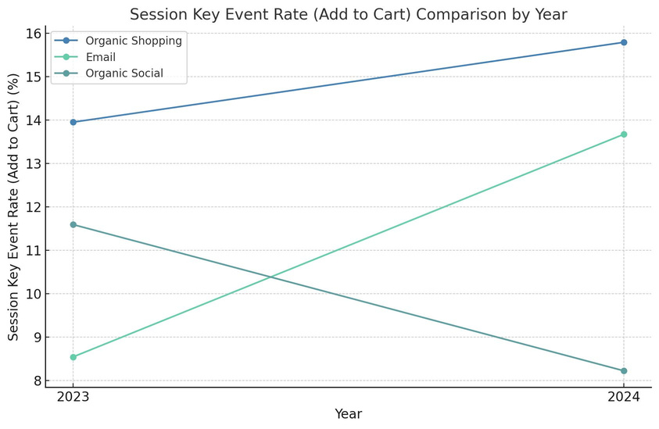
CONVERSION RATE: ADD TO CART
Observations:
For both 2023 and 2024, Organic Shopping accounted for the largest share of session key event rates (Add to Cart).
Email campaigns witnessed the highest improvement in the "Add to Cart" rate between 2023 and 2024. This could be due to an improvement in email marketing strategies or effectiveness.
Organic Social, however, experienced a decline in its event rate, consistent with its reduced share in the pie chart. This decline might indicate the need to revisit strategies or investments in this category to regain lost traction.

Slide 18
RECOMMENDATIONS
Make the Most of Organic Shopping Success:
Keep building on the strong performance of Organic Shopping by focusing on SEO improvements. Ensure your product pages are easy to find and attractive to potential customers, with engaging descriptions and clear visuals.
Step Up Email Campaigns:
Take advantage of the boost in "Add to Cart" rates from email marketing by making your emails more personal and relevant. Include tailored product suggestions and special offers to keep customers coming back.
Reignite Organic Social Engagement:
Social media is a powerful tool—bring it back to life by posting interactive and relatable content. Partner with influencers, share user-generated posts and create campaigns that connect with your audience.
Focus on What Converts:
Double down on the channels driving results, like Email and Organic Shopping. Add time-limited deals or personalized offers to keep customers excited and ready to purchase.
Connect Your Channels Seamlessly:
Make sure customers have a smooth journey no matter where they find you, whether it’s through an email or social media. A unified experience will make your brand feel reliable and easy to interact with.

Slide 19

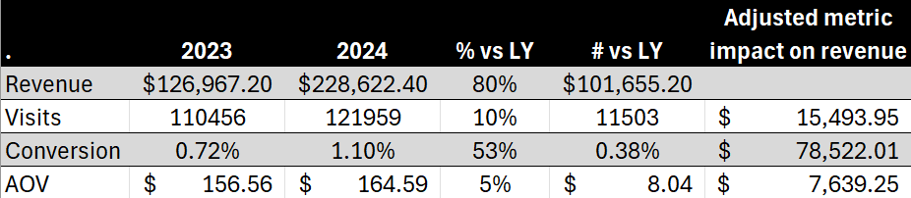
WATERFALL TABLE
Despite a 10% increase in Visits (Sessions) and a 5% rise in Average Order Value (AOV), the overall positive impact on revenue is most significant due to a 53% increase in Conversion Rate, which contributed substantially to the revenue growth. Consequently, revenue has grown by 80%, resulting in a net gain of $101,655.20 compared to the previous year.

Slide 20
RECOMMENDATIONS
Sustain Conversion Rate Growth:
Focus on optimizing user experience and checkout processes to maintain and further improve the significant 53% increase in conversion rate.
Boost Traffic:
Invest in targeted marketing campaigns, such as social media ads and SEO, to build on the 10% increase in visits and attract more users.
Maximize AOV Potential:
Introduce upselling, cross-selling, and premium product bundles to capitalize on the 5% growth in AOV.
Retarget Existing Users:
Use personalized remarketing campaigns to re-engage past customers and abandoned cart users for repeat purchases.
Refine Category Performance:
Identify and promote high-performing categories while optimizing or discontinuing underperforming ones to align with customer demand.

